Slide 1
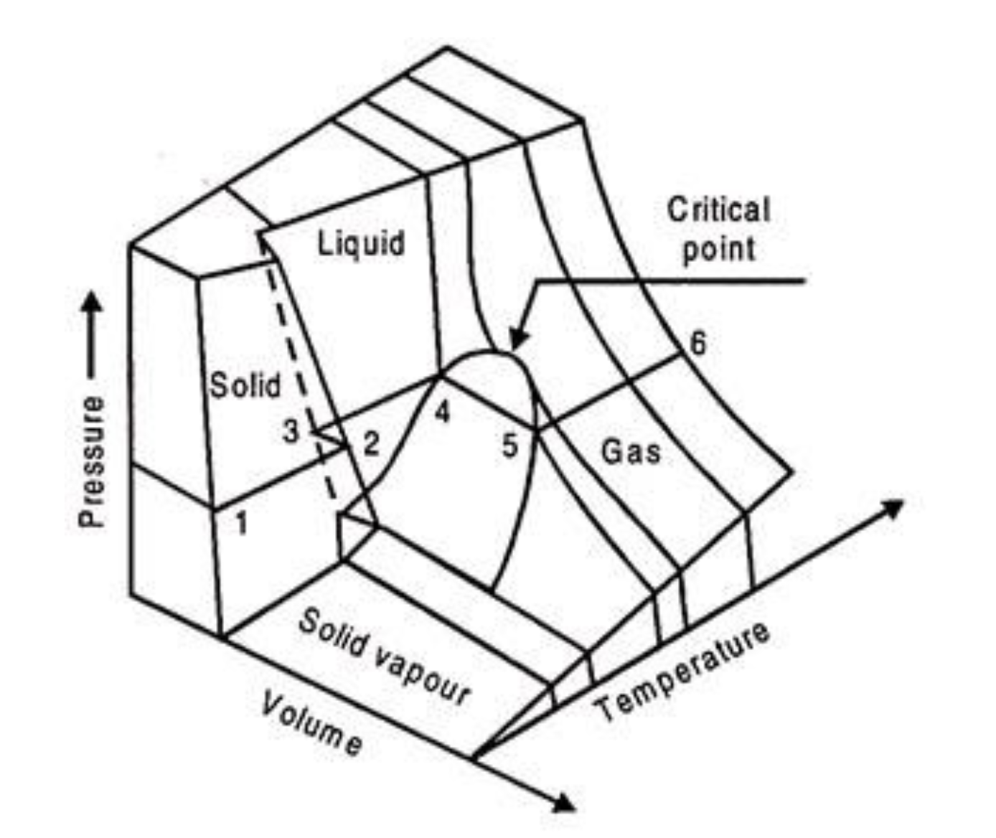
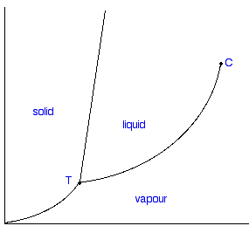
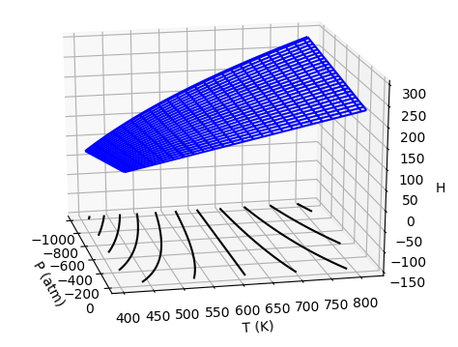
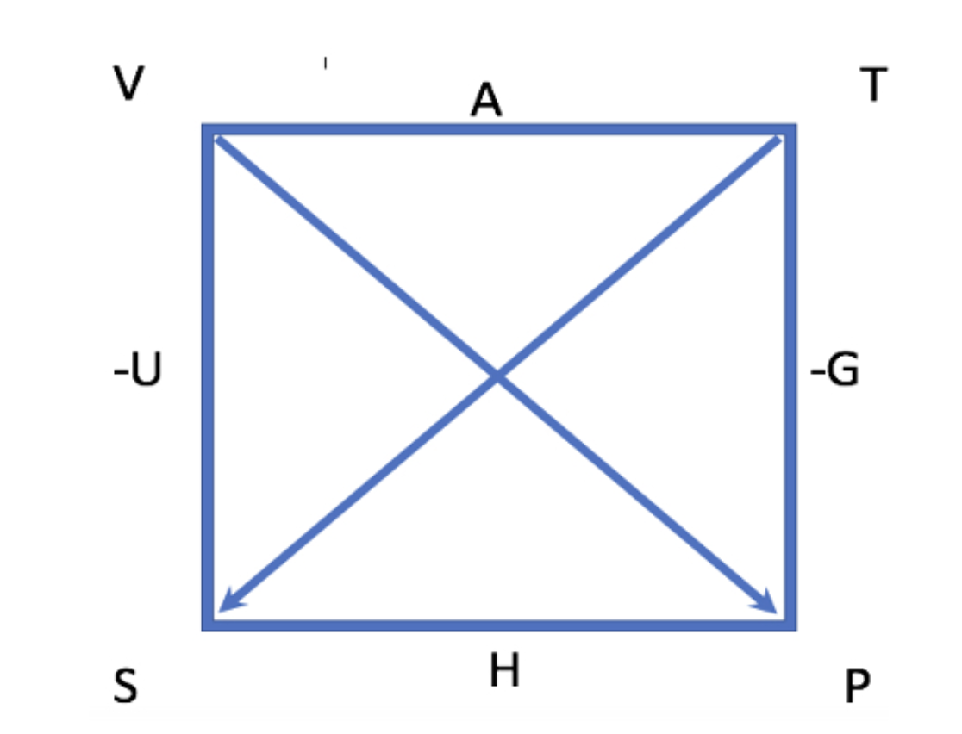
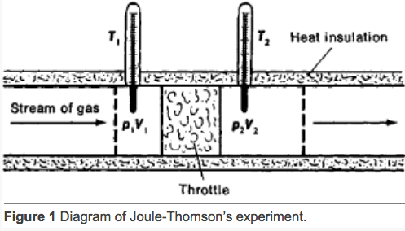

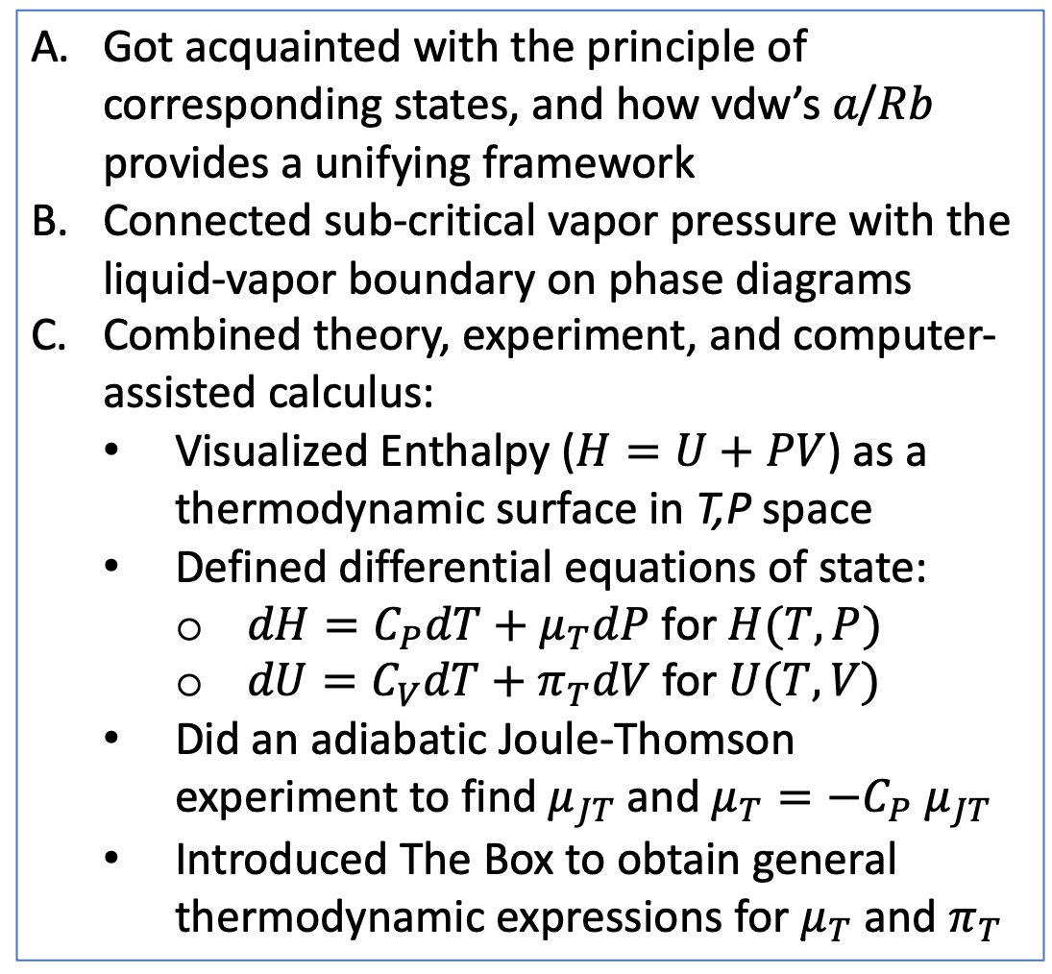
What we did this week
Got acquainted with the principle of corresponding states, and how vdw’s 𝑎/𝑅𝑏 provides a unifying framework
Connected sub-critical vapor pressure with the liquid-vapor boundary on phase diagrams
Combined theory, experiment, and computer-assisted calculus:
Visualized Enthalpy ($H=U+PV$) as a thermodynamic surface in T,P space
Defined differential equations of state:
$dH=C_{P}dT+μ_{T}dP$ for $H(T,P)$
$dU=C_{V}dT+π_{T}dV$ for $U(T,V)$
Did an adiabatic Joule-Thomson experiment to find $μ_{JT}$ and $μ_{T}=−C_{P}{ μ}_{JT}$
Introduced The Box to obtain general thermodynamic expressions for $μ_{T}$ and $π_{T}$
$$T<T_{c}$$

Slide 2
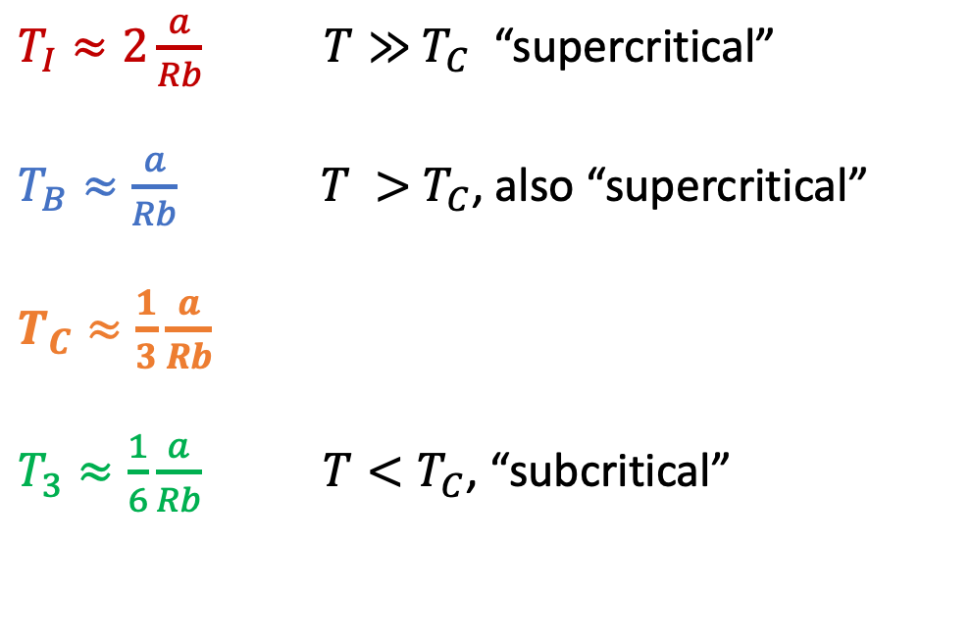
A. How van der Waals $\frac{a}{Rb}$ provides a unifying framework for multiple phenomena
$T_{I}≈2\frac{a}{Rb}$ $T≫{ T}_{C}$ “supercritical”
$T_{B}≈\frac{a}{Rb}$ $T >{ T}_{C}$, also “supercritical”
$T_{C}≈\frac{1}{3}\frac{a}{Rb}$
$T_{3}≈\frac{1}{6}\frac{a}{Rb}$ $T<T_{C}$, “subcritical”
https://www.engineeringenotes.com/thermal-engineering/real-gases/real-gases-properties-van-der-waals-equation-and-equation-of-state-thermal-engineering/49112

Slide 3
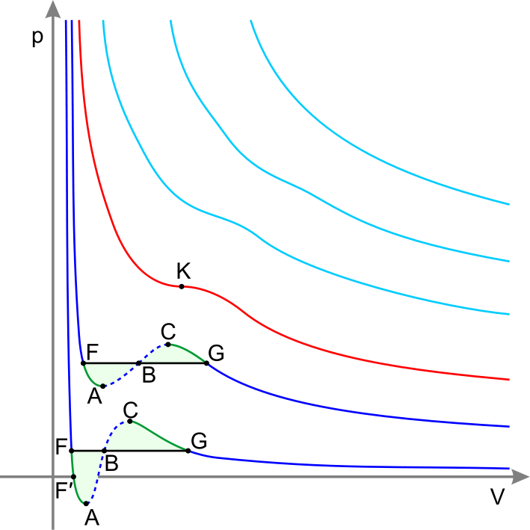


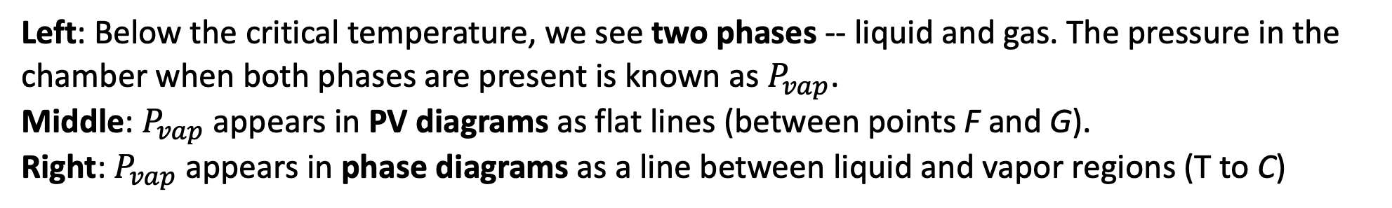

B. Connection between sub-critical vapor pressure and phase diagrams
Left: Below the critical temperature, we see two phases -- liquid and gas. The pressure in the chamber when both phases are present is known as $P_{vap}$.
Middle: $P_{vap}$ appears in PV diagrams as flat lines (between points F and G).
Right: $P_{vap}$ appears in phase diagrams as a line between liquid and vapor regions (T to C)
$$T<T_{c}$$
PV diagram
Phase diagram
$$P$$
gas
gas
liquid
$$T$$

Slide 4
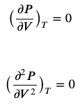




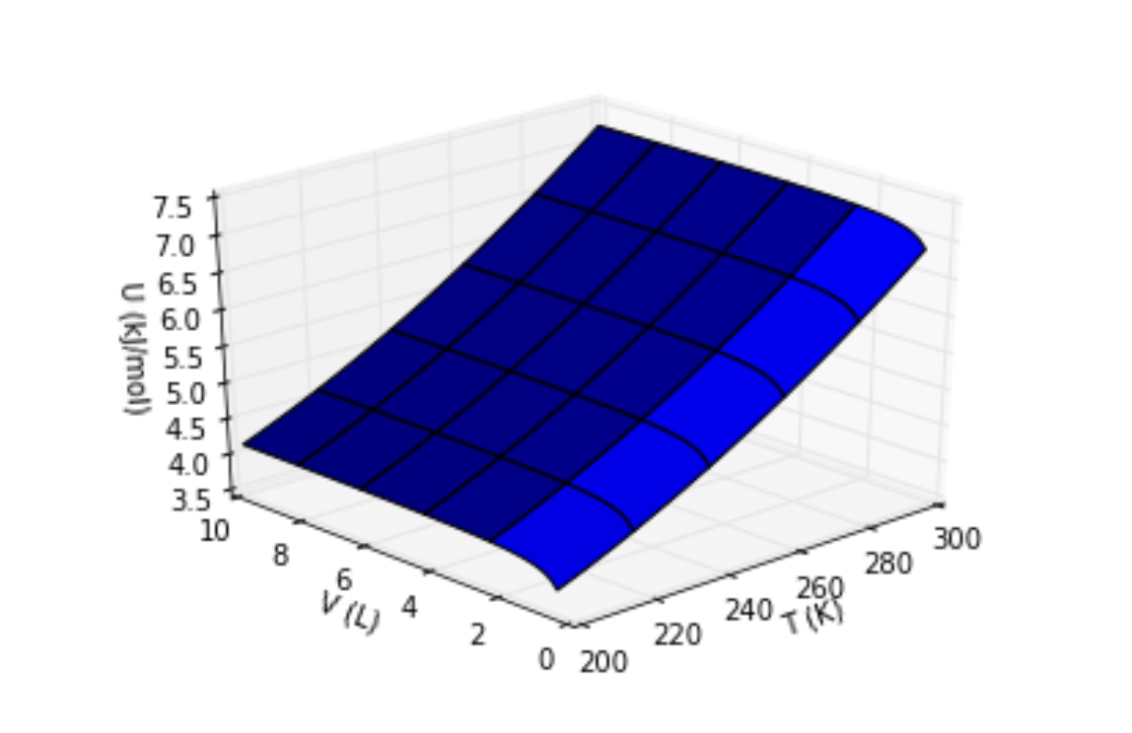
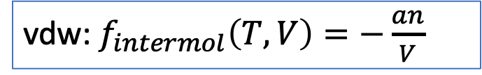
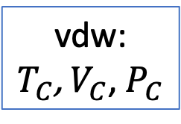

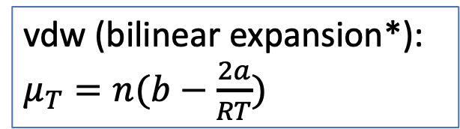
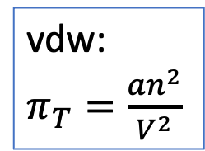
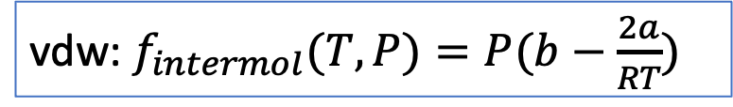
C. Combined theory, experiment, and computer-assisted calculus
AnalyticalTcrit (diff calculus)
vdw:
$T_{C}$, $V_{C}$, $P_{C}$
$P=P(T,V)$
AnalyticalMuT & The Box
vdw:
$π_{T}=\frac{an^{2}}{V^{2}}$
vdw (bilinear expansion*): $μ_{T}=n(b−\frac{2a}{RT})$
AnalyticalUH (integral calculus)
vdw: $f_{intermol}\left(T,V\right)=−\frac{an}{V}$
vdw: $f_{intermol}(T,P)=P(b−\frac{2a}{RT})$
VisualizingU
VisualizingH

Slide 5

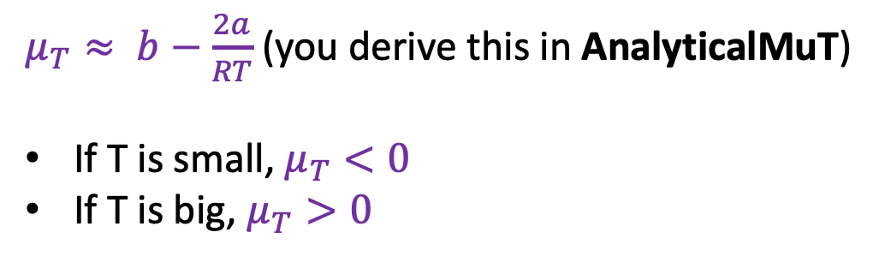
1. Find an algebraic expression for the inversion temperature in terms of vdw a and b
$μ_{T}≈ b−\frac{2a}{RT}$ (you derive this in AnalyticalMuT)
If T is small, $μ_{T}<0$
If T is big, $μ_{T}>0$
Set $μ_{T}=0$ and solve for $T$ to get $T_{I}$.

Slide 6
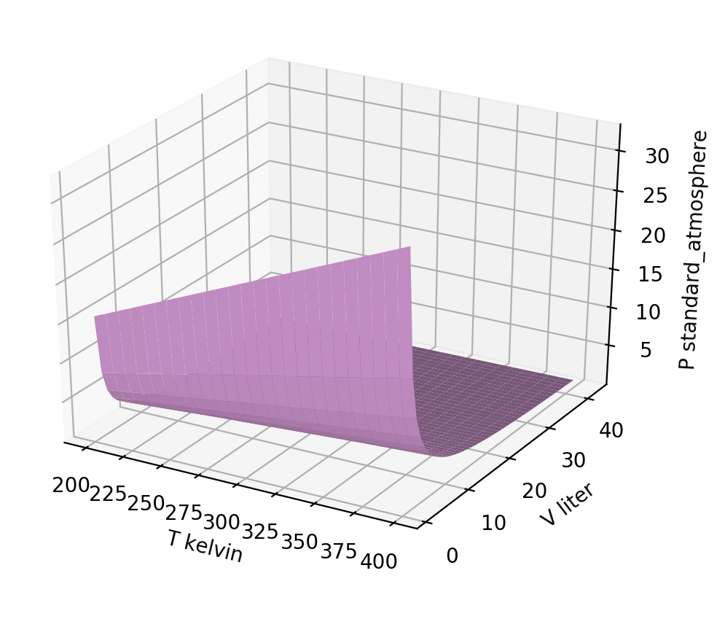


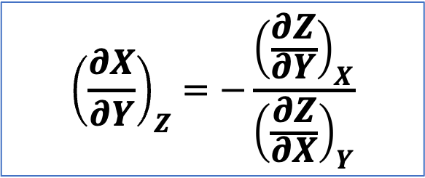

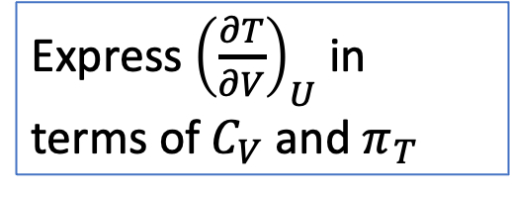
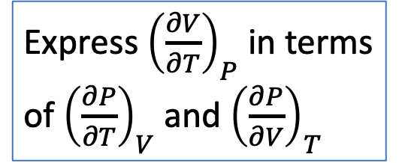


2. Practice the Euler Chain Relation
The Euler Chain Relation connects slopes to each other.
It’s especially useful when ${\left(\frac{∂X}{∂Y}\right)}_{Z}$ is a contour of a surface we’re interested in.
$${\left(\frac{∂X}{∂Y}\right)}_{Z}=−\frac{{\left(\frac{∂Z}{∂Y}\right)}_{X}}{{\left(\frac{∂Z}{∂X}\right)}_{Y}}$$
Express ${\left(\frac{∂V}{∂T}\right)}_{P}$ in terms of ${\left(\frac{∂P}{∂T}\right)}_{V}$ and ${\left(\frac{∂P}{∂V}\right)}_{T}$
$$π_{T}$$
Express ${\left(\frac{∂T}{∂V}\right)}_{U}$ in terms of $C_{V}$ and $π_{T}$
$$C_{V}$$
$$C_{P}$$
$$μ_{T}$$
Express $μ_{JT}$ (which equals ${\left(\frac{∂T}{∂P}\right)}_{H}$) in terms of $C_{P}$ and $μ_{T}$

